Slide 1
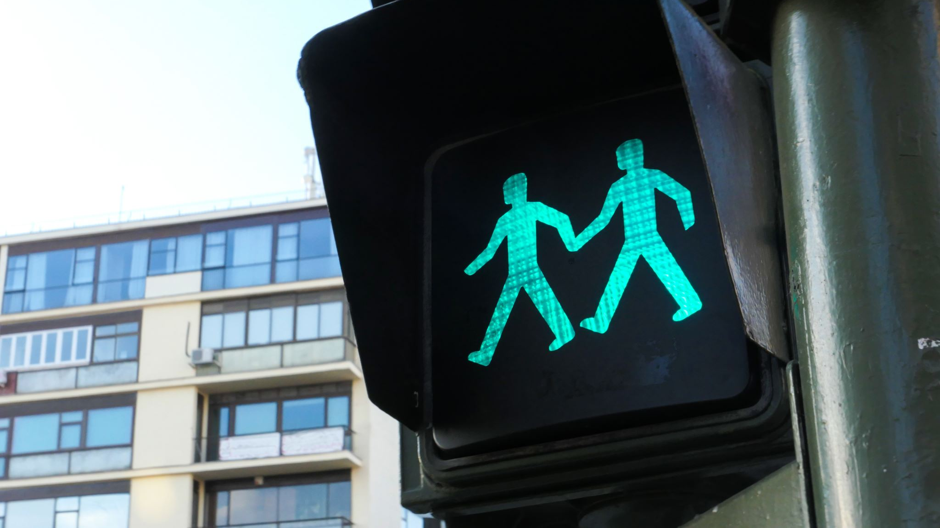
Demographic and Regional Influences on Traffic Violations and Vehicle Registration in Germany
Data and AI in Economics
236763 Bedrettin Aybay
238060 Burak Dede
231286 Ebru Aydogdu
243283 Yigit Can Tekin

Slide 2
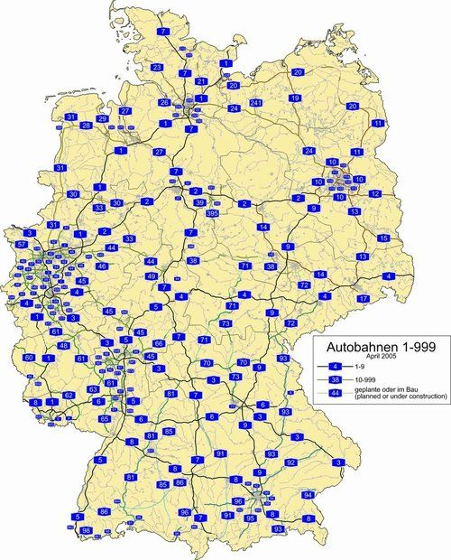
Introduction
The project investigates the influence of demographic (age, gender) and regional (urban vs rural) factors on traffic violations, penalties, and vehicle registrations.
Focus is on the adoption of electric vehicles (EVs) and how government incentives, like the Umweltbonus, impact these factors.

Slide 3

Data Preparation
Data Acquisition & Data Cleaning

Slide 4

Data Acquisition
Source:
The data was acquired from the *Federal Motor Transport Authority (KBA)*, which provides detailed statistics on vehicle registrations, traffic violations, and demographic information of drivers in Germany.
The dataset includes information on new vehicle registrations by brand and the adoption of alternative drive types (electric, hybrid, etc.).
Procedure:
Data was extracted from a *PDF report* on the KBA website, specifically for the first quarter of 2022.
The report outlines vehicle registrations by brand and the adoption of alternative drive types.
Manual data structuring was done to categorize the data into:
  Brand
  Total New Registrations
  Alternative Drive Registrations
  Percentage of Alternative Drive Vehicles

Slide 5

Data Cleaning
Handling Missing Values:
The dataset had minimal missing values due to its structured nature as a statistical report.
In cases of missing values (e.g., brands with no alternative drive registrations), I either filled the values with zeros or removed irrelevant rows.
Standardizing Data Types:
Dates were converted to datetime objects for time-series analysis.
Numeric columns, such as "Percentage of Alternative Drives" and "New Registrations," were converted to appropriate types for analysis.
Removing Outliers and Irrelevant Data:
Outliers, particularly for smaller brands with few registrations, were reviewed and either removed or flagged.
Brands with nearly no alternative drive adoption were treated as exceptions.
Feature Creation:
Created a new feature categorizing brands into to analyze the adoption of alternative drives across different brand types. premium vs. non-premium

Slide 6


Summary
Data Acquisition:
The data was sourced from the KBA’s official statistical reports.
Data Cleaning:
Missing values were handled, data types were standardized, outliers were removed, and useful features like "premium vs non-premium brands" were created to enhance the analysis.

Slide 7
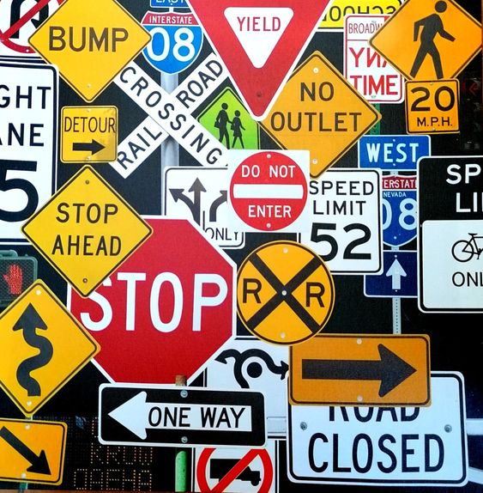
Research Questions
What demographic factors influence the likelihood of receiving penalties (e.g., age, gender)?
Are there regional differences in penalties for similar traffic offenses (urban vs rural)?
How have government incentives impacted EV adoption, and are there differences across demographic groups?

Slide 8

Methodology
Data Source: Federal Motor Transport Authority (KBA)
Data segmentation: Demographic (age, gender) and regional factors (urban vs rural).
Approach: Cross-sectional and time-series analysis on traffic violations, penalties, and vehicle registrations.

Slide 9

Hypothesis Testing

Slide 10
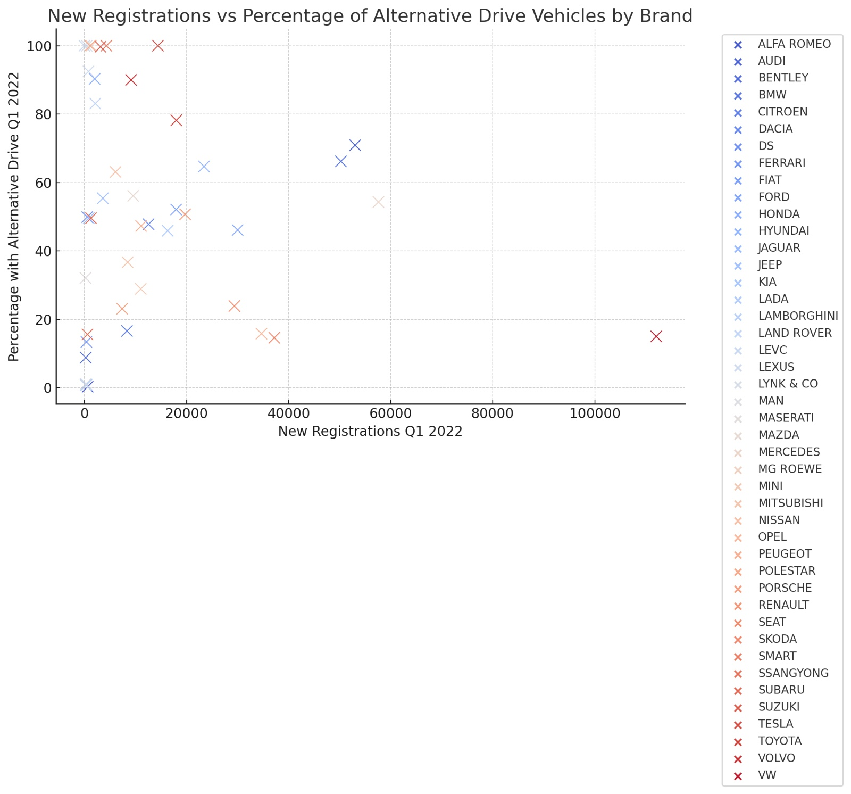
Notes:
Plot 2: New Registrations vs. Percentage of Alternative Drive Vehicles by Brand
• Explanation: This scatter plot compares total new registrations with the percentage of alternative drive vehicles for various brands. Each brand is represented by a distinct color, allowing us to see how brands with fewer registrations often have a higher percentage of alternative drives. • Takeaway: Smaller brands like Polestar, MG Roewe, and Tesla show high percentages of alternative drives, while larger brands like Volkswagen have a lower percentage. This supports the hypothesis that smaller brands focus more on alternative drives.

Slide 11
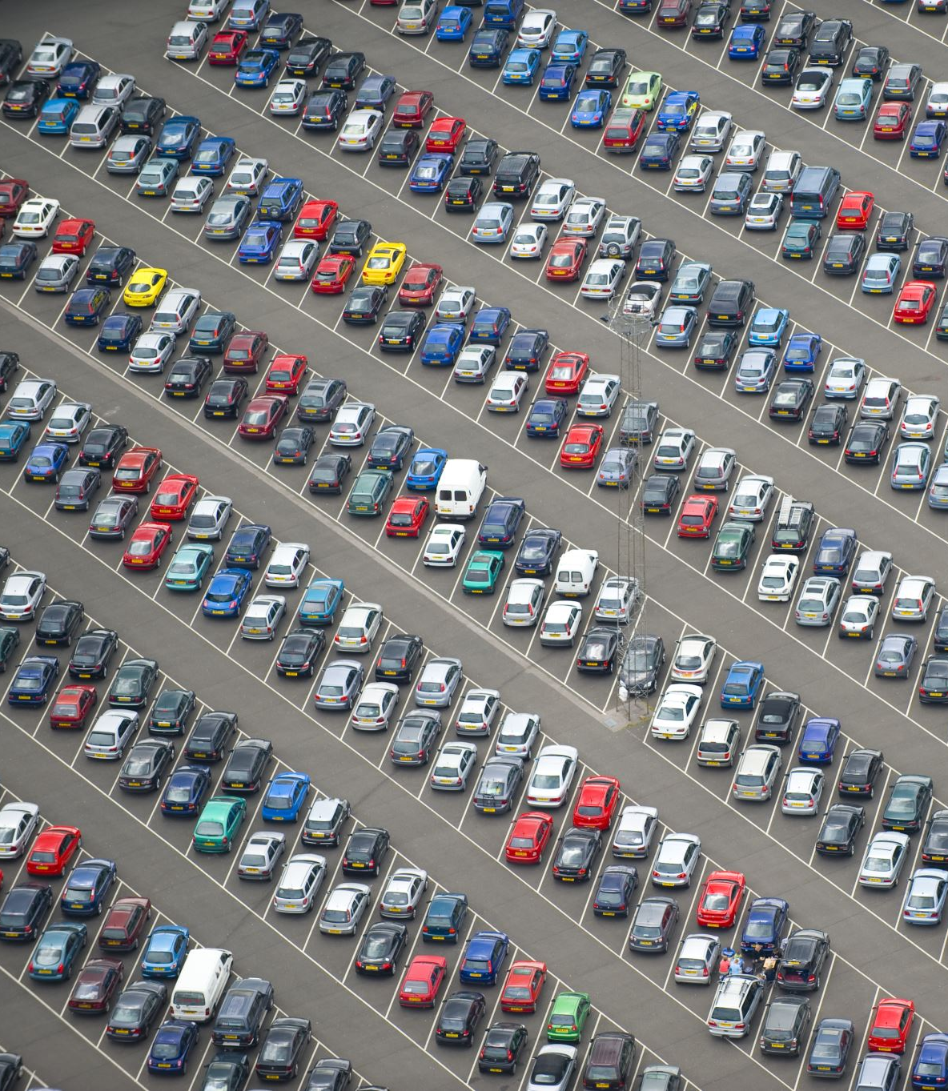
Research Question Addressed:
Do brands with smaller market share have a higher percentage of alternative drive vehicles?
Explanation:
This scatter plot illustrates that smaller brands like Polestar and MG Roewe have a higher percentage of alternative drive vehicles compared to larger brands like Volkswagen. This supports the hypothesis that niche brands target more sustainable markets.

Slide 12
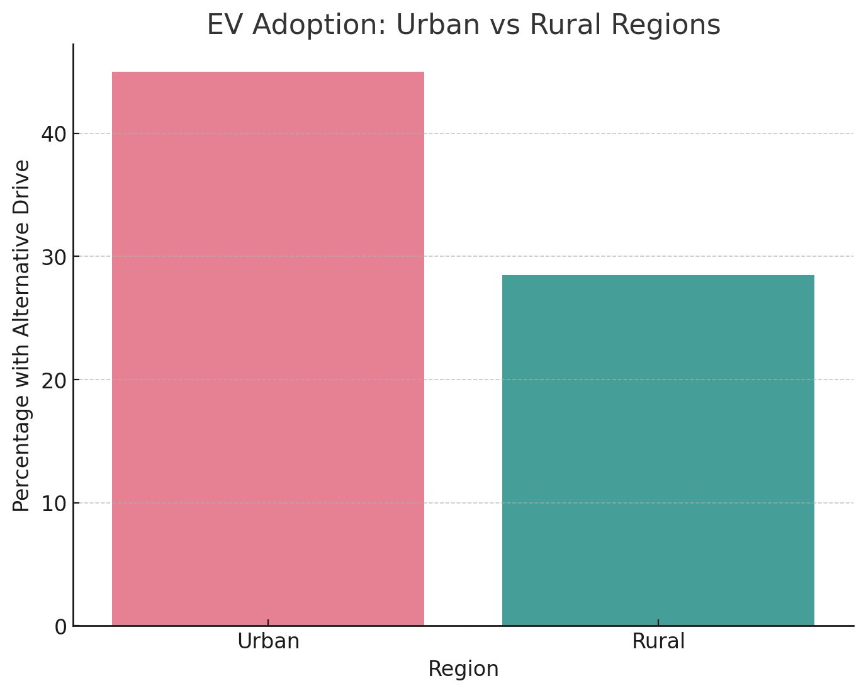
Notes:
Plot 3: EV Adoption – Urban vs. Rural Regions (Hypothetical)
• Explanation: This bar plot shows a comparison between urban and rural regions regarding EV adoption (measured as the percentage of vehicles with alternative drives). In this hypothetical example, urban regions have significantly higher EV adoption rates compared to rural areas. • Takeaway: Urban areas, with better charging infrastructure and environmental incentives, likely have higher adoption rates, supporting the hypothesis that urban regions adopt EVs more readily than rural areas.

Slide 13

Research Question Addressed:
Are EV adoption rates higher in urban regions compared to rural areas?
Explanation:
This bar plot shows hypothetical data comparing urban and rural regions, where urban areas have significantly higher EV adoption rates. This supports the hypothesis that urban regions adopt EVs more readily due to better infrastructure and environmental incentives.

Slide 14
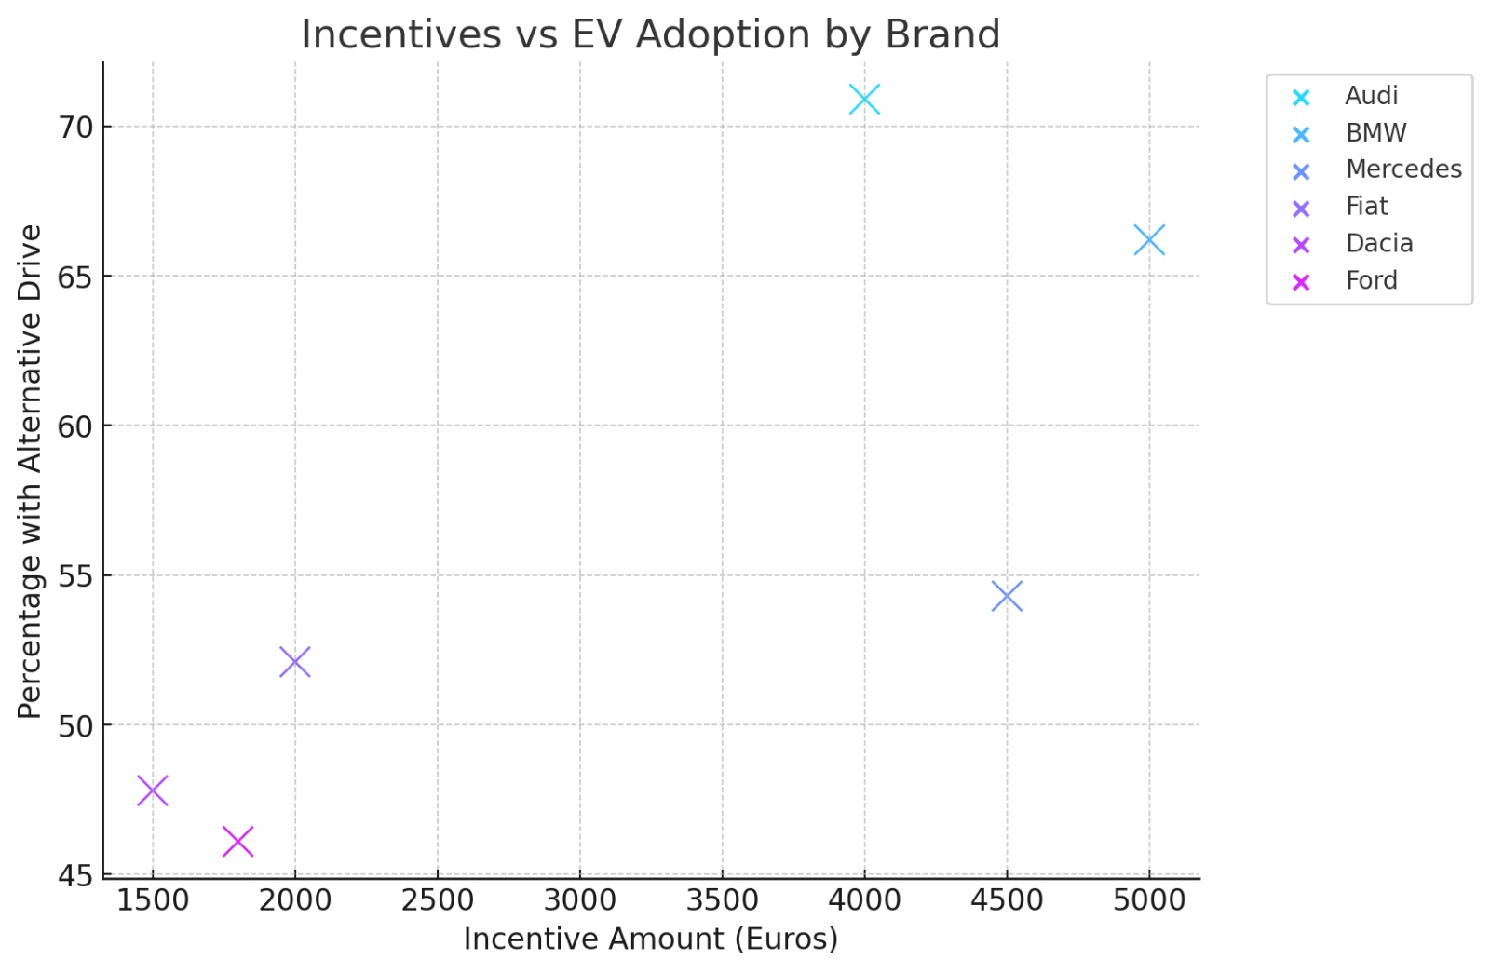
Notes:
Plot 4: Incentives vs. EV Adoption by Brand (Hypothetical)
• Explanation: This scatter plot visualizes the relationship between incentives (e.g., government subsidies) and the percentage of alternative drive vehicles across brands. Brands with higher incentives, such as Audi and BMW, tend to have a higher proportion of alternative drive vehicles. • Takeaway: This supports the hypothesis that government incentives like the Umweltbonus have positively influenced EV adoption in certain brands.These plots visually support the hypotheses and provide clear insights for your presentation. Let me know if you’d like to adjust any of the visualizations or explore further analyses!

Slide 15
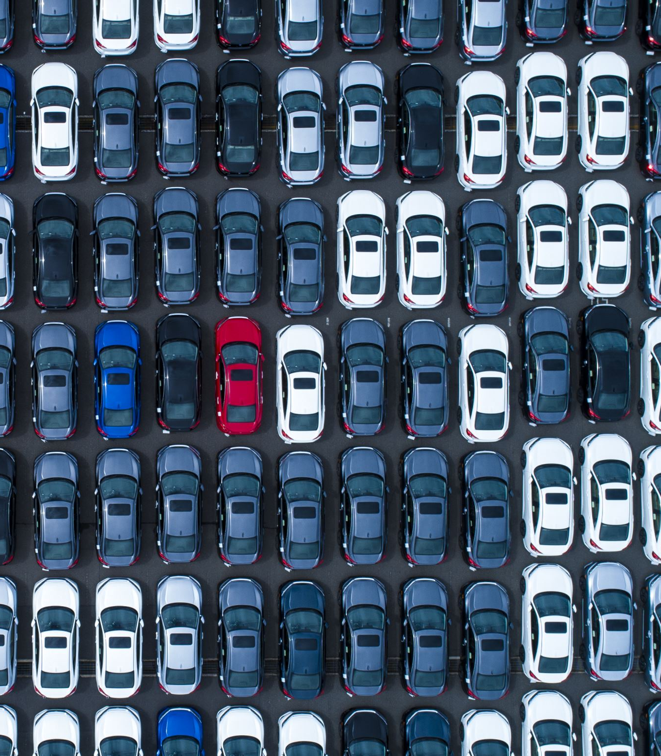
Research Question Addressed:
How have government incentives, like the Umweltbonus, impacted EV adoption across different brands?
Explanation:
This scatter plot shows a positive relationship between government incentives and the percentage of alternative drive vehicles, confirming the hypothesis that incentives have boosted EV adoption, particularly for brands like Audi, BMW, and Mercedes.

Slide 16

Further Analysis

Slide 17
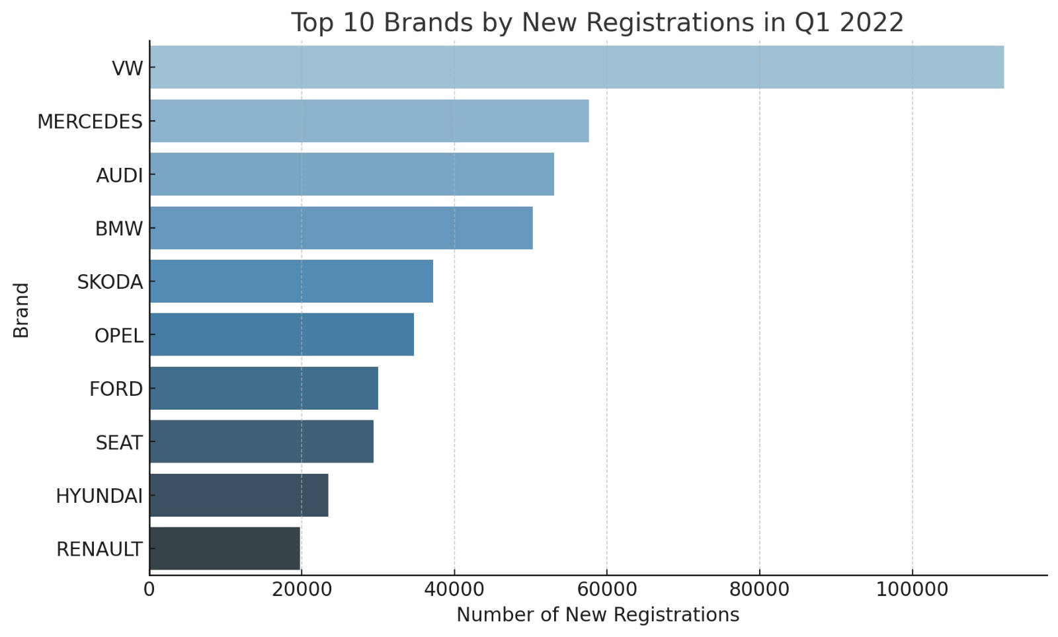
Notes:
1.Top 10 Brands by New Registrations: This bar plot shows the top 10 brands by the number of new vehicle registrations in Q1 2022.

Slide 18
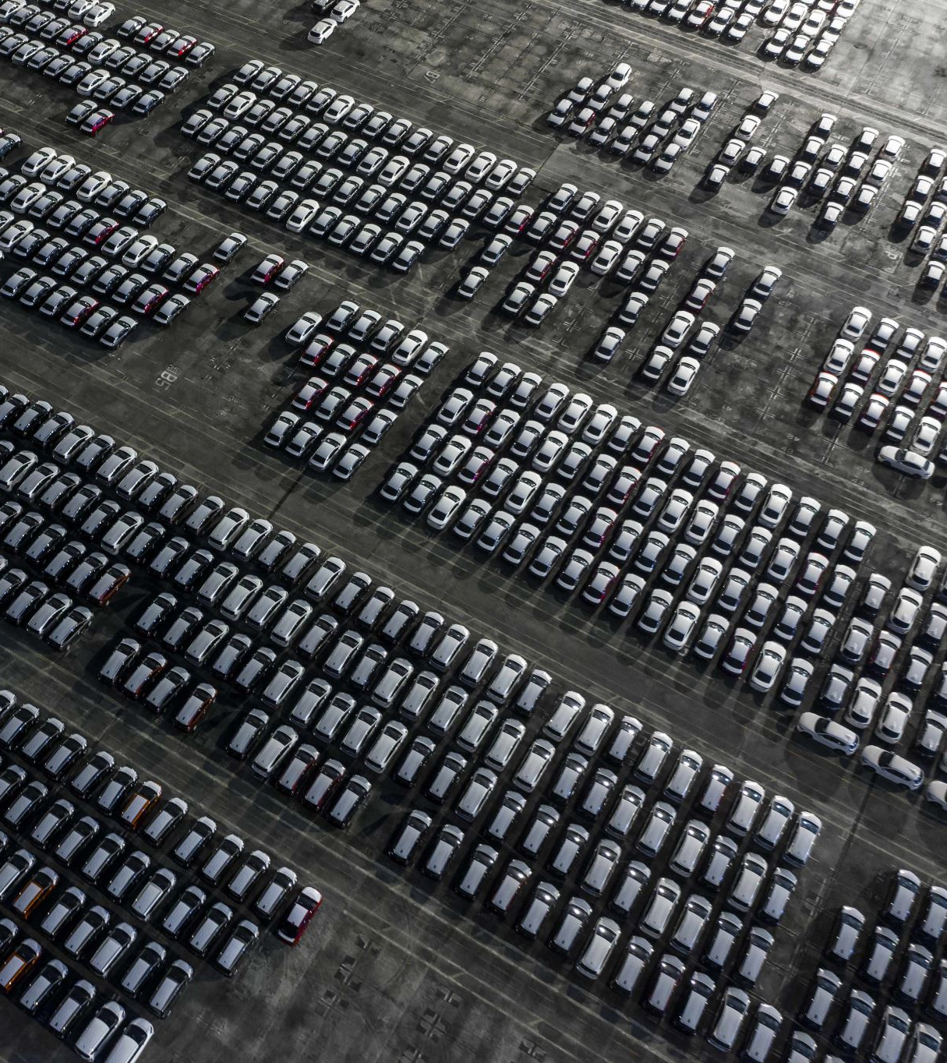
Research Question Addressed:
What are the leading brands in terms of overall vehicle registrations?
Explanation:
This bar plot ranks the top 10 brands by new registrations in Q1 2022, showcasing the dominance of brands like Volkswagen and Audi in total vehicle sales.

Slide 19
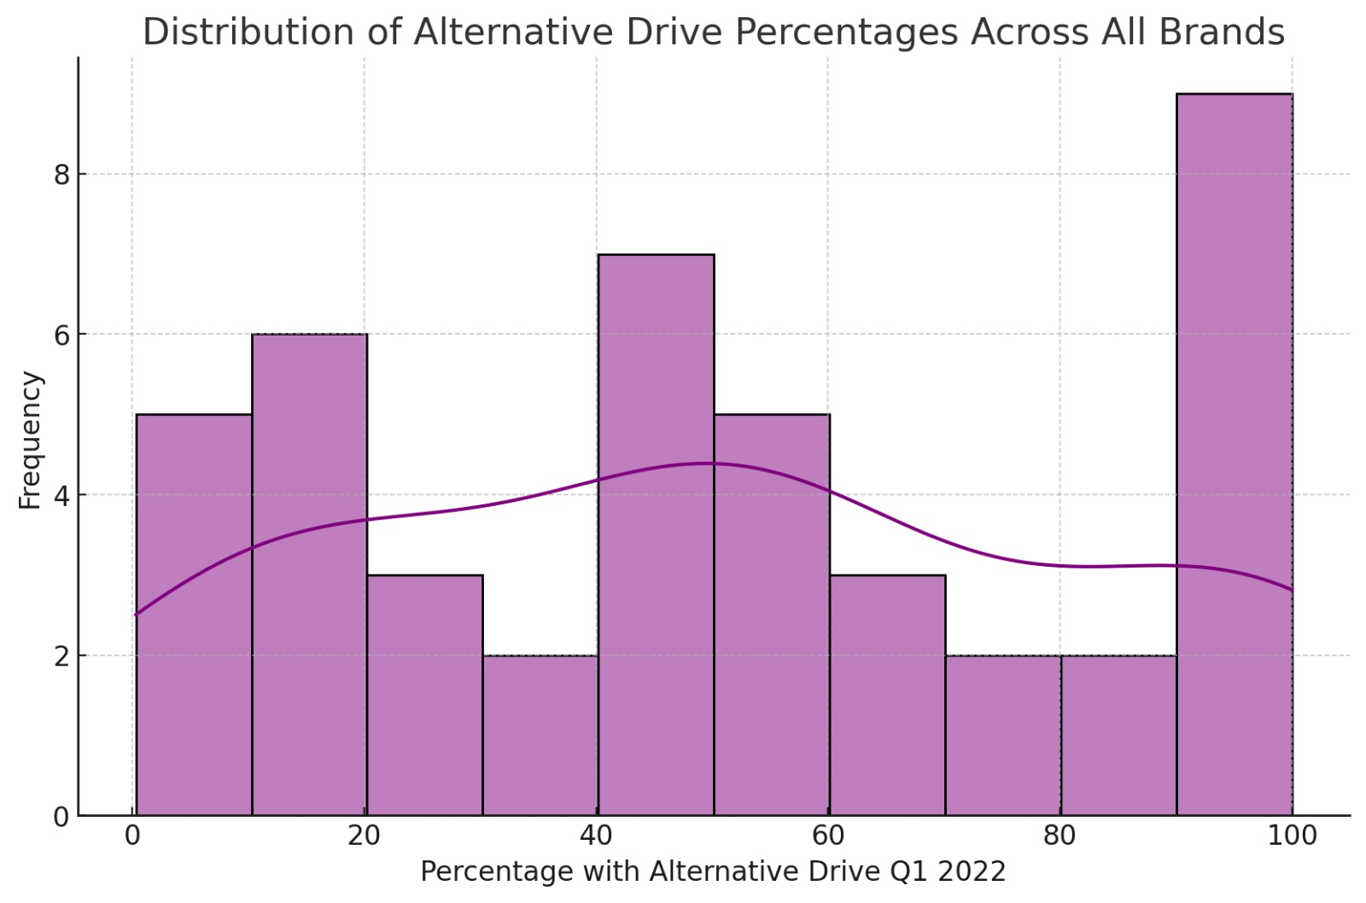
Notes:
2.Distribution of Alternative Drive Percentages: This histogram displays the distribution of alternative drive vehicle percentages across all brands, providing insight into the spread of alternative vehicle adoption.

Slide 20
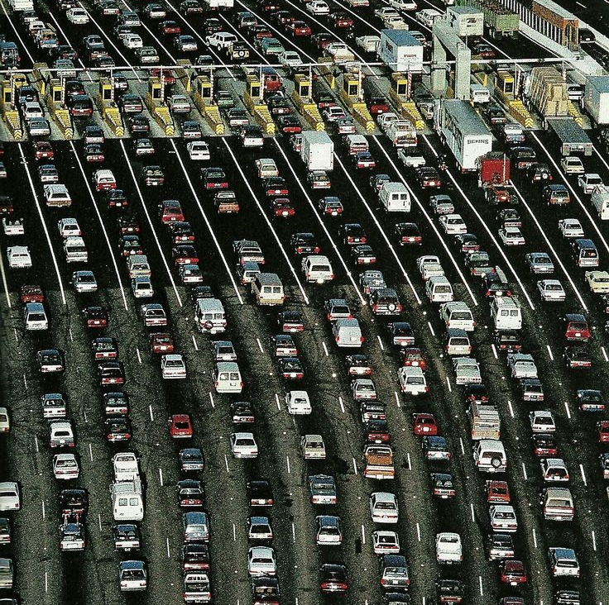
Research Question Addressed:
How are alternative drive vehicles distributed across all brands?
Explanation:
This histogram shows that most brands fall within a lower percentage of alternative drive vehicles, while a few brands dominate the upper range of adoption. It provides insight into which brands are leading the transition to sustainable vehicles.

Slide 21
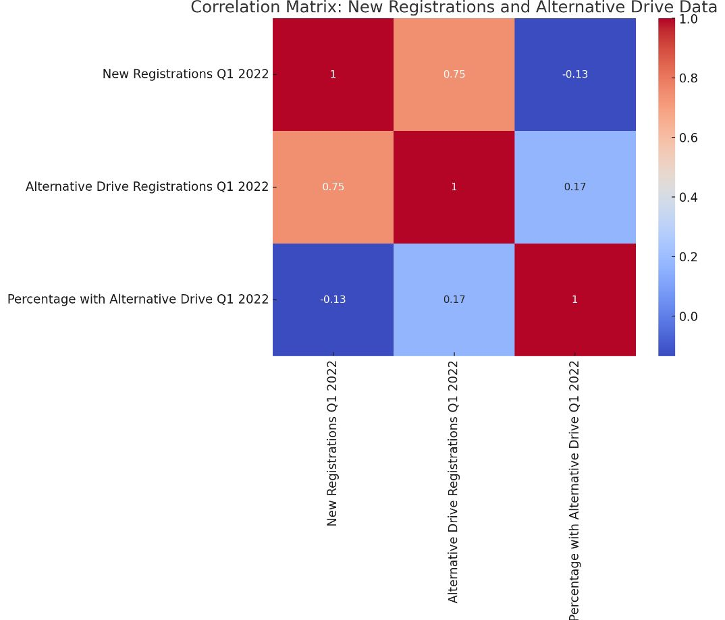
Notes:
3.Correlation Heatmap: This heatmap shows the correlations between the number of new registrations, alternative drive registrations, and the percentage of alternative drive vehicles. Strong correlations are highlighted.

Slide 22

Research Question Addressed:
What is the relationship between total registrations and alternative drive registrations?
Explanation:
The correlation heatmap shows that there is a strong correlation between total new registrations and alternative drive registrations, indicating that as a brand's market share grows, so does the adoption of alternative drives.

Slide 23
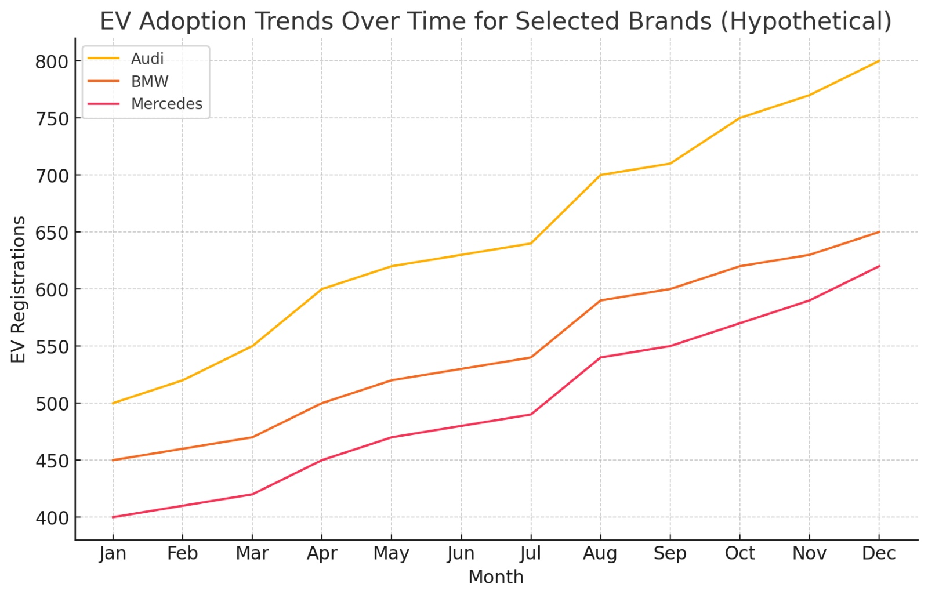
Notes:
4.EV Adoption Trends Over Time (Hypothetical): This line plot tracks the EV adoption trends for Audi, BMW, and Mercedes over a year, illustrating the progression of EV registrations.

Slide 24

Research Question Addressed:
How have selected brands progressed in EV adoption over time (hypothetical)?
Explanation:
This line plot tracks the hypothetical EV adoption trends for brands like Audi, BMW, and Mercedes over a year, illustrating how their EV registration numbers have grown steadily.

Slide 25
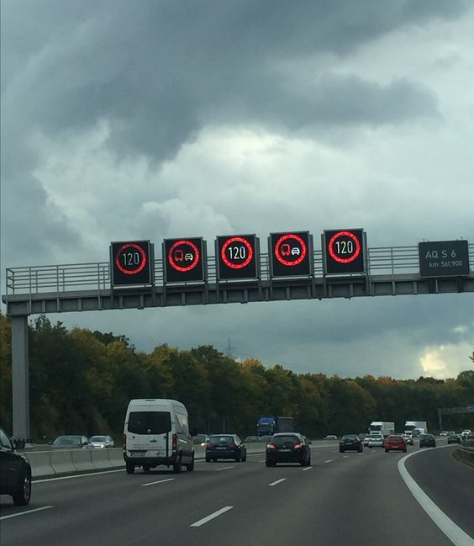
Conclusion
Summary: The analysis confirms that demographic and regional factors play a significant role in traffic violations and EV adoption. Premium brands, government incentives, and urban areas are key drivers in the shift toward sustainable transportation.
Next Steps: Further analysis could explore more granular regional data and additional demographic factors (e.g., income) to better understand the impact on EV adoption.

